Slide 1

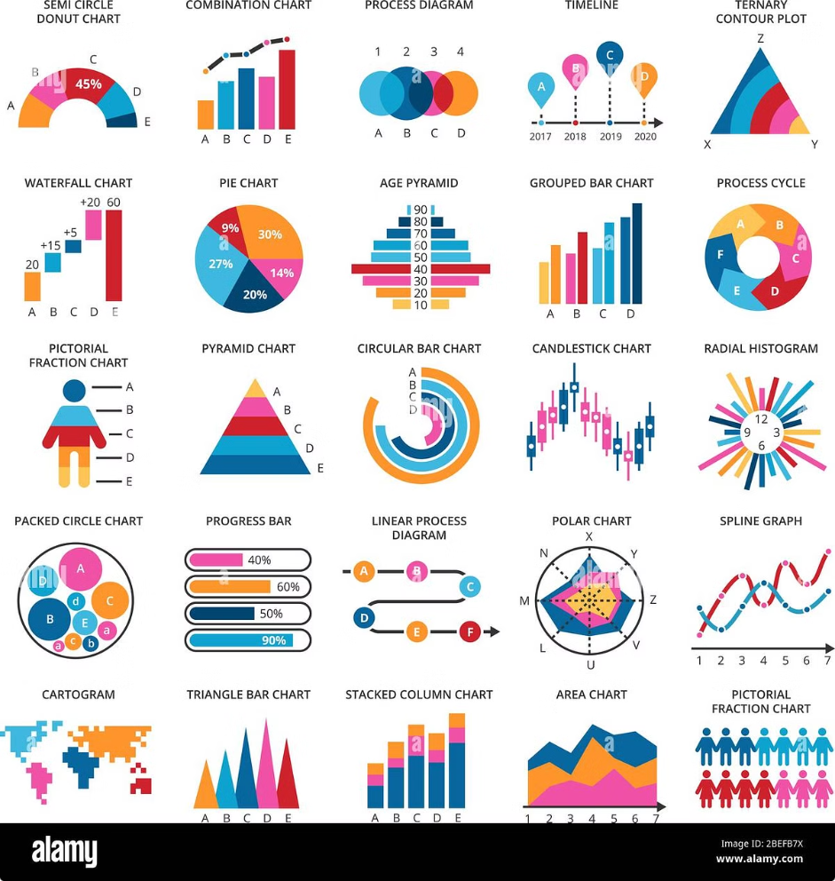
Real-Time Credit Card Fraud Detection
This presentation outlines the development of a real-time credit card fraud detection system for financial transactions using machine learning. The project aims to identify and prevent fraudulent activities in financial transactions by leveraging advanced machine learning algorithms.
Team Members: Mohd Shadmaan, Ayush, Nitesh, Sharman, Luxmi

Slide 2
Project Objective
The objective of this project is to create a real-time credit card fraud detection system for financial transactions using machine learning.
Goal
Approach
To develop a system that can identify and prevent fraudulent activities in financial transactions.
Leveraging advanced machine learning algorithms to analyze transaction data and detect suspicious patterns and create a web app so the user can interact with ML model easily.

Slide 3
Project Workflow
1
Environment Setup
Setting up the necessary software and libraries for the project, including Python, MySQL, Docker, Scikit-learn, Pytest, and Git/GitHub.
2
Version Control with Git/GitHub
Utilizing Git for version control and GitHub for collaborative code management, ensuring efficient tracking of changes and code sharing among team members.
3
Database Integration (MySQL)
Integrating MySQL for database management, storing and retrieving transaction data for analysis and model training.
4
Model Development (Various ML models)
Developing and evaluating various machine learning models, including logistic regression, random forest, naive Bayes, KNN, SVM, and decision tree, to identify the most effective model for fraud detection.
5
Testing (Using Pytest)
Thorough testing of the developed models and system using Pytest to ensure accuracy, reliability, and robustness.
6
Containerization (Docker)
Containerizing the application using Docker for efficient deployment and portability, ensuring consistent execution across different environments.
7
UI Representation
Developing a user-friendly interface for visualizing the results of the fraud detection system, providing insights and actionable information to users.

Slide 4

PROJECT WORKFLOW
GIT Version Control
Under - Sampling
Dataset
Data Preprocessing (Feature Selection, Scaling, etc)
Machine Learning Model
Over - Sampling
Deployed Streamlit Webapp
Docker

Slide 5
Tools and Technologies
Python (pandas for data manipulation)
MySQL (for database management)
Docker (for containerization)
Scikit-learn (for machine learning models)
Pytest (for testing)
Git/GitHub (for version control)
Streamlit (for UI)

Slide 6
Dataset Used
Credit card fraud detection datasets (creditcard.csv)
Source: Kaggle - Credit Card Fraud Detection
The project utilized credit card fraud detection datasets, specifically the "creditcard.csv" file.
The dataset was sourced from Kaggle, a platform for data science and machine learning competitions, under the "Credit Card Fraud Detection" category.

Slide 7
My Contributions
Installation of required software
Created GitHub repository
Installing the necessary software and libraries for the project, including Python, MySQL, Docker, Scikit-learn, Pytest, and Git/GitHub.
Created the GitHub repository for the project, providing a centralized platform for collaborative code management and version control.
Integrated MySQL database
Built models-Random Forest
Developed Random Forest models and tested logistic regression and decision tree on oversampled data.
Integrated the MySQL database, enabling the storage and retrieval of transaction data for analysis and model training.
Performed basic analysis and undersampling (also tried oversampling)
Containerized the application with Docker and uploaded the image to Docker Hub for team access
EDA and Conducted basic analysis of the dataset.
Containerized the application using Docker, ensuring efficient deployment and portability.

Slide 8

Contributions of Other Members
Ayush
Installation, GitHub repo creation, MySQL integration, undersampling, Logistic regression ML model, Docker containerization
Nitesh
Installation, GitHub repo creation, MySQL integration, and testing with Pytest
Sharman
Installation, GitHub repo creation, MySQL integration, oversampling, code merging, UI development
Luxmi
Installation, GitHub repo creation, MySQL integration, decision tree model development

Slide 9
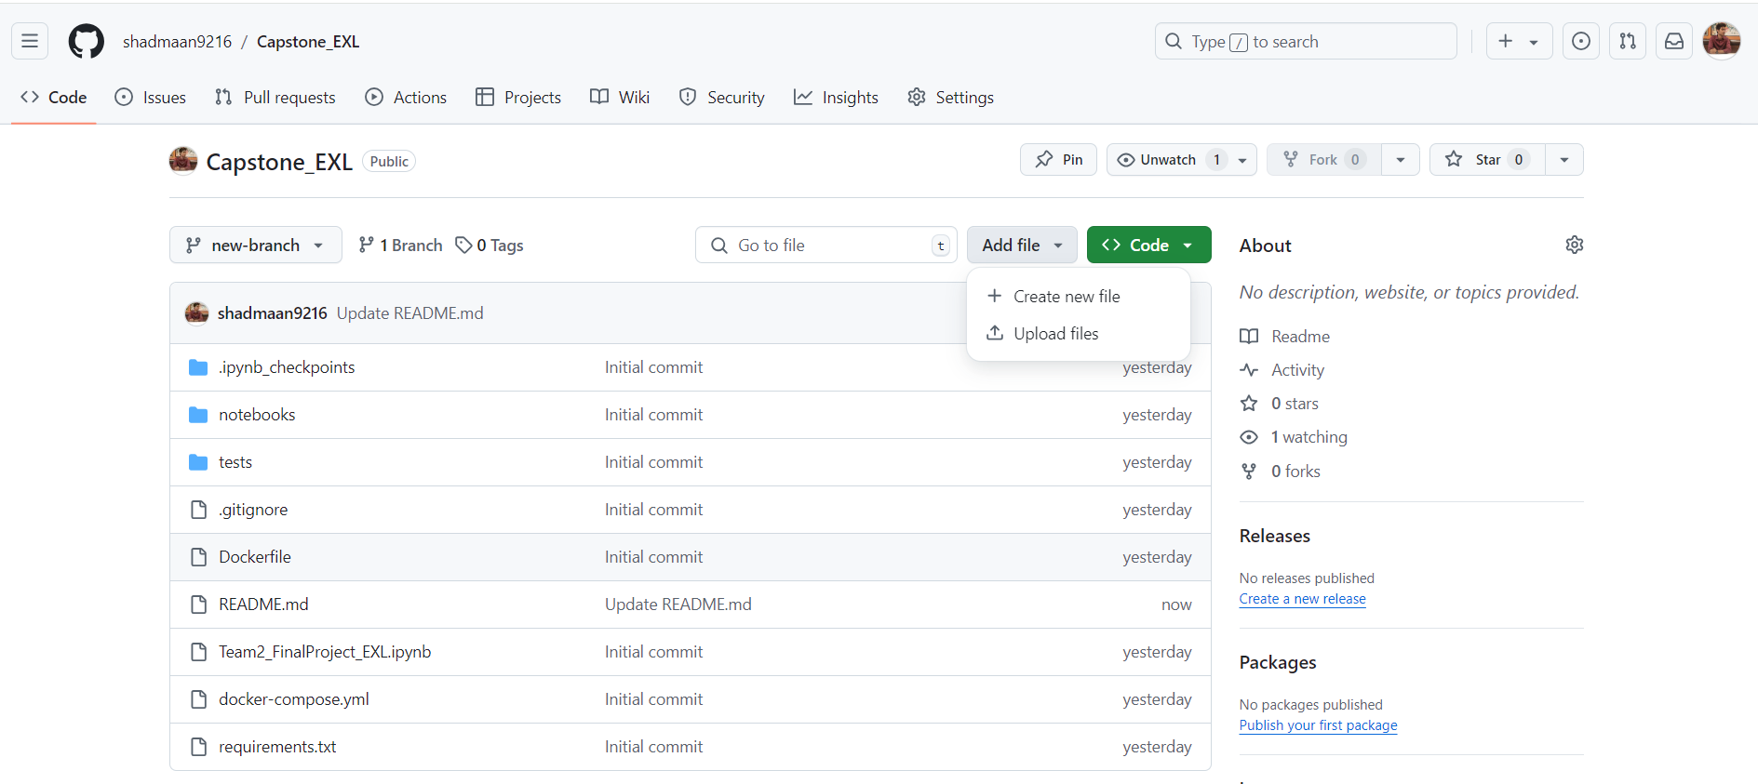
Images of Project
Git Hub :

Slide 10
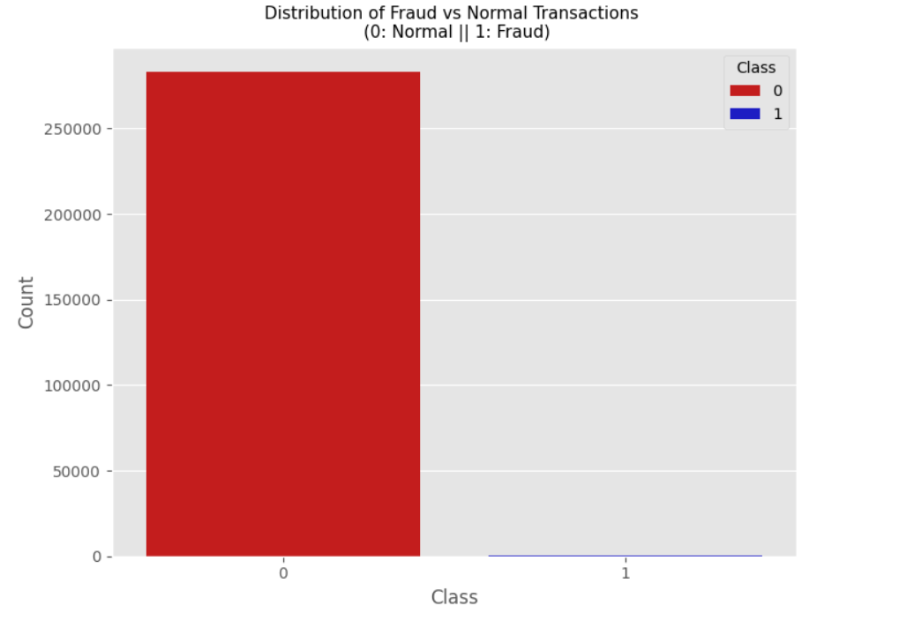

Slide 11
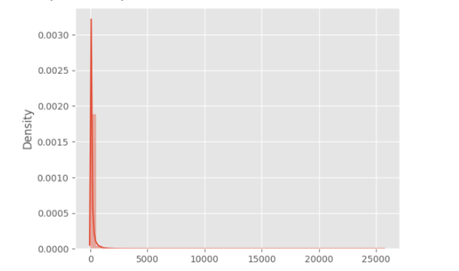
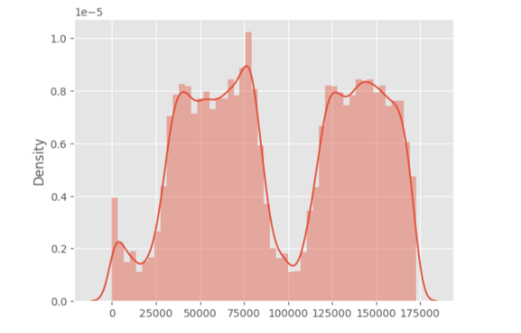
Distribution of Amount
Distribution of Time

Slide 12
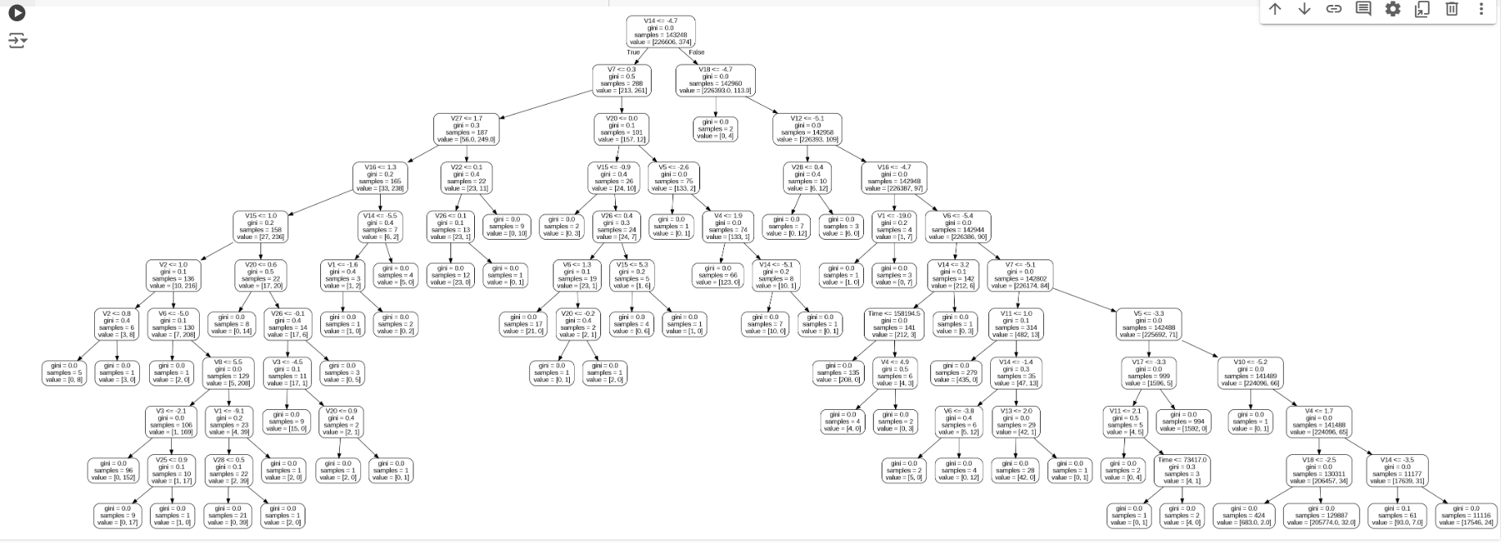
Distribution of Amount
Distribution of Time

Slide 13
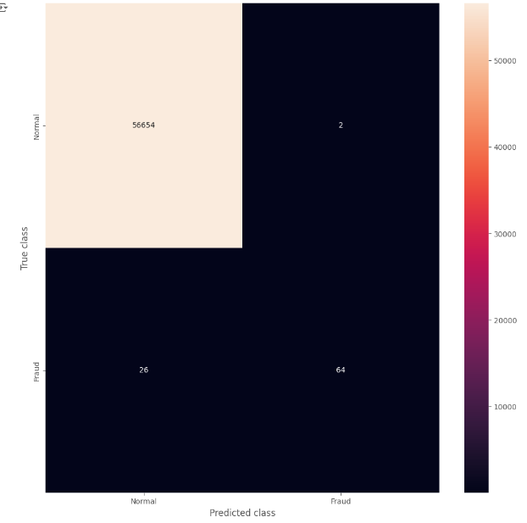
Without Scaling & over and under sampling

Slide 14
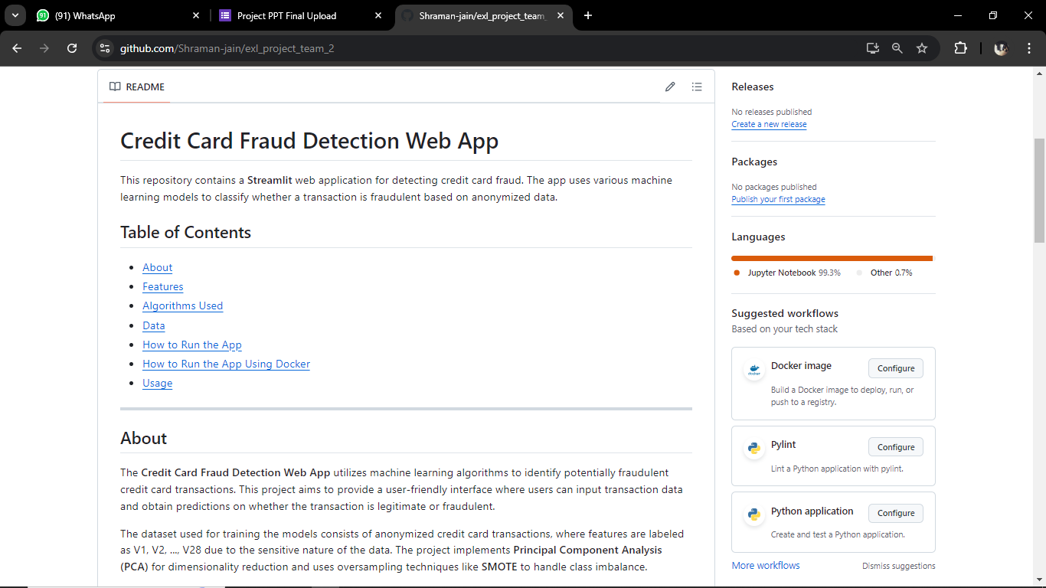
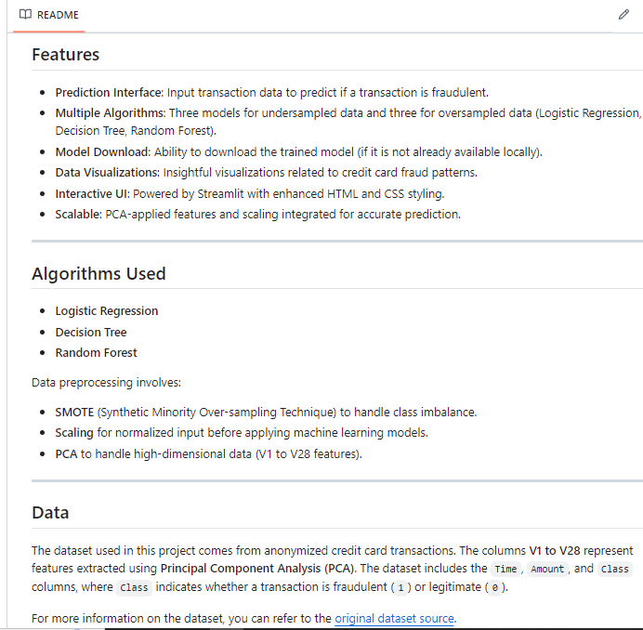
GitHub Readme:

Slide 15
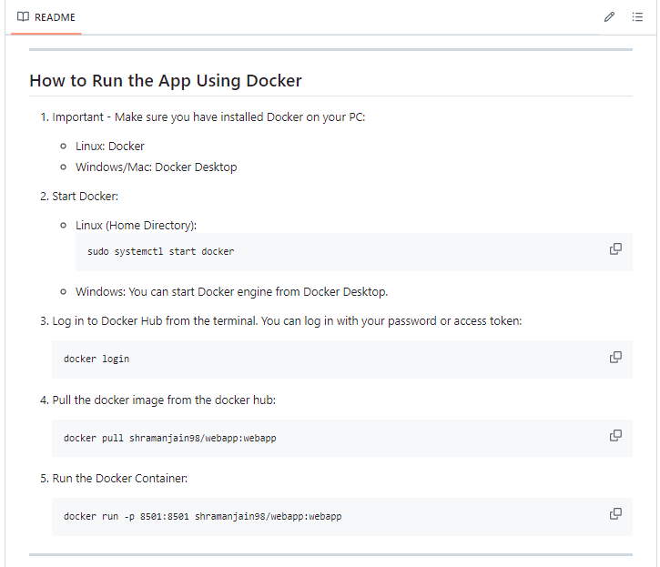
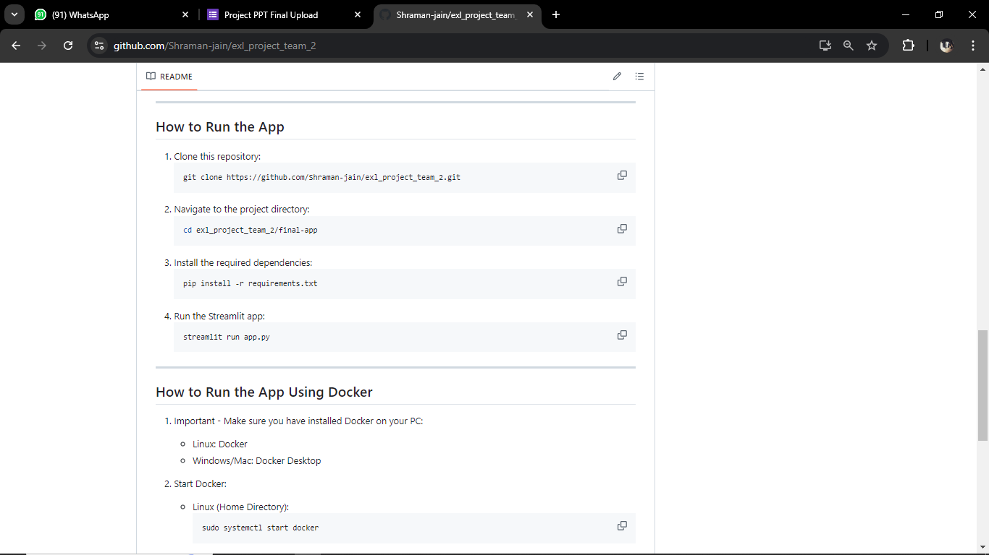
How to Run the App;
2. Using Docker
1. Using Github

Slide 16
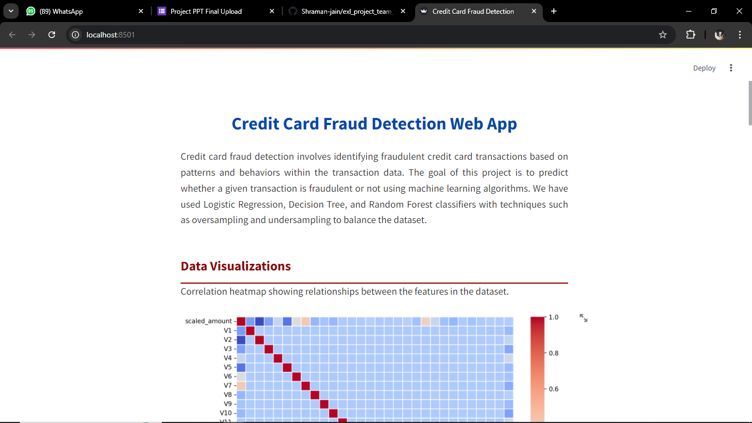
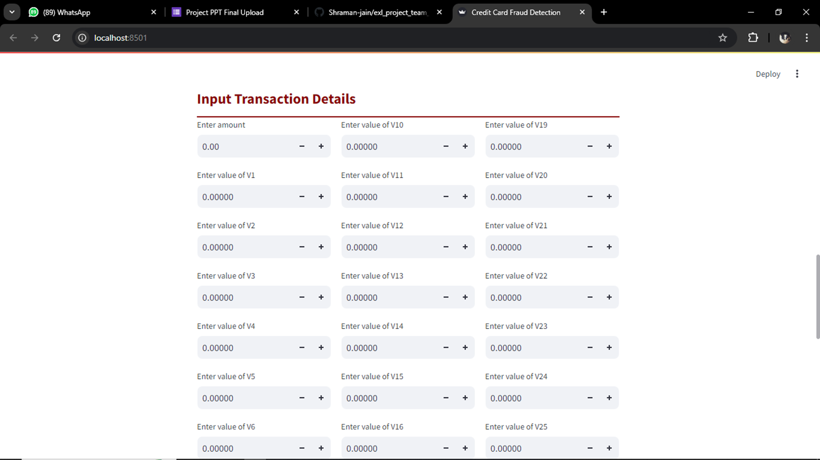
Streamlit Webpp :

Slide 17
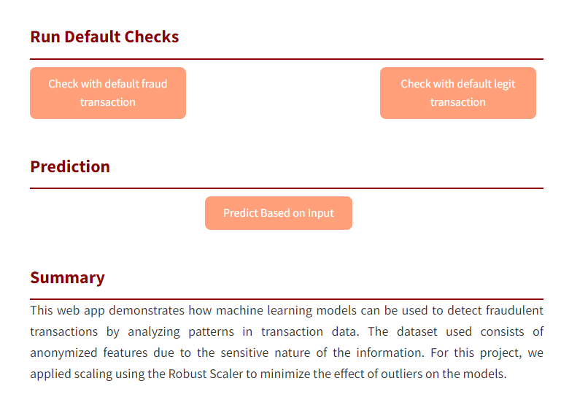
Streamlit Webpp :

Slide 18
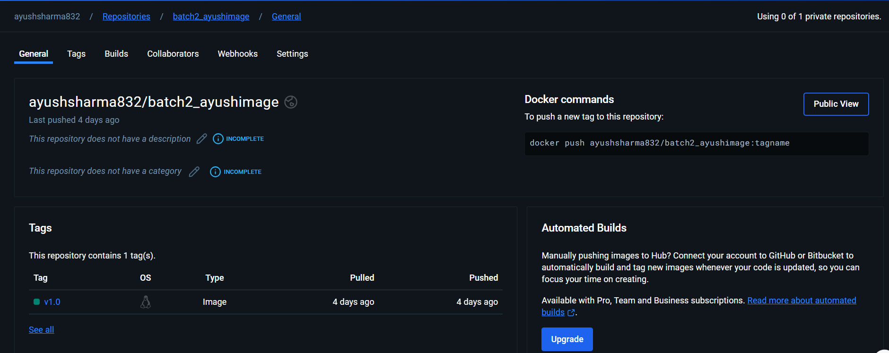
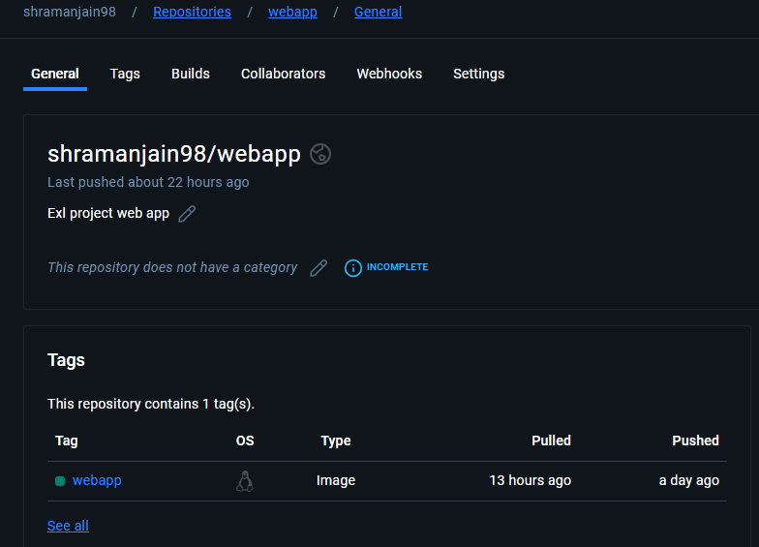
Docker Hub Image

Slide 19
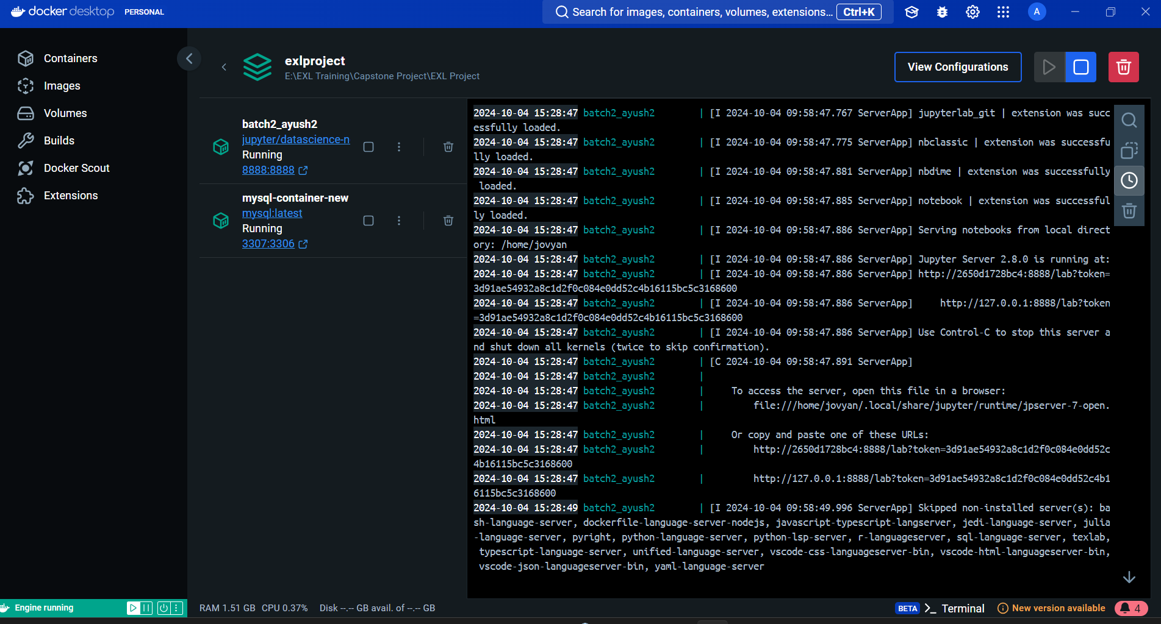
Docker Containers Running (mysql and jupyter) - in GUI

Slide 20
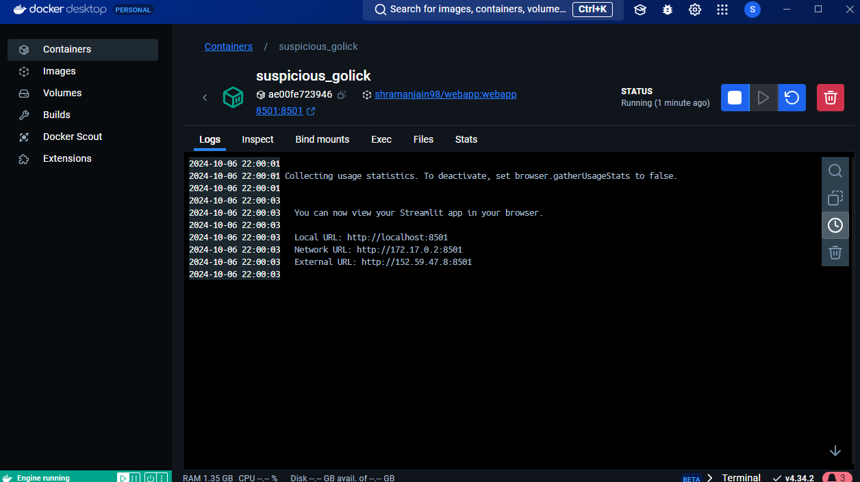
Docker Containers Running (Streamlit WebApp) - in GUI

Slide 21
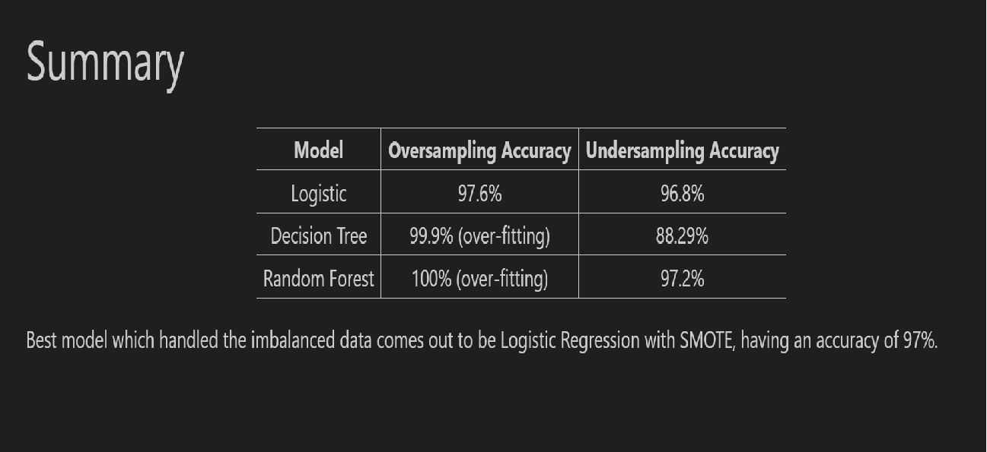
Accuracy obtained using the models :

